Slide 1
Team: The Winners
Angel Alex, Daugherty
Angel Lucia, RGA
Angel Joe, Daugherty
Angel Venus, Daugherty
Problem Statement:
Wearable devices monitoring is not tied to usage
This is one of the top 12 potential problem statements for RGAx

Slide 2
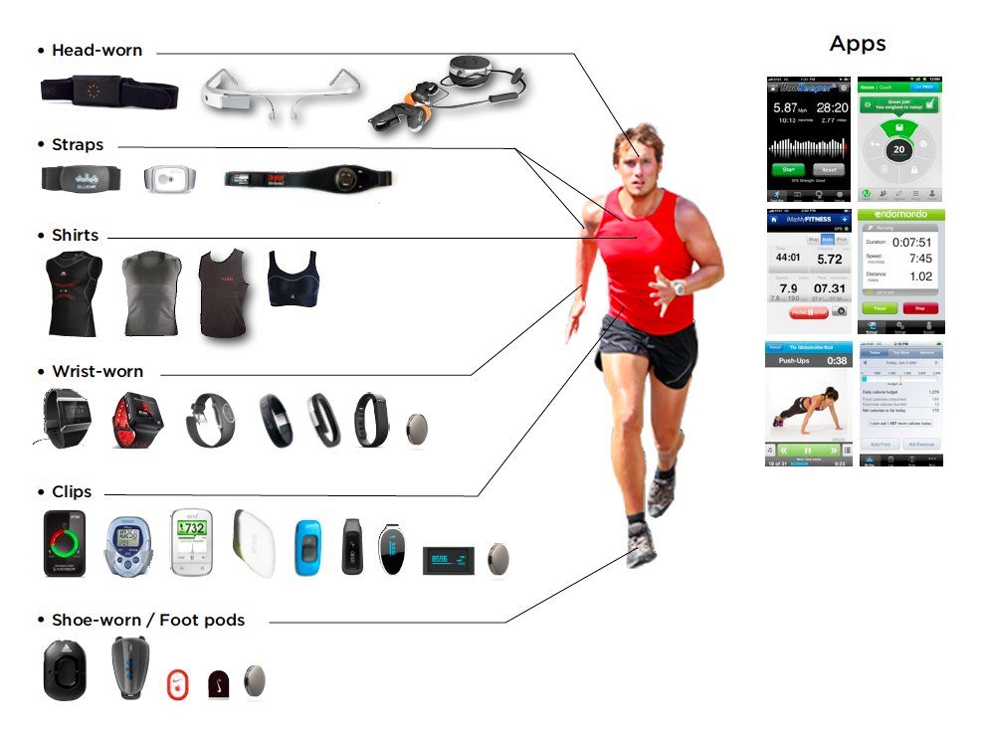


Solution Concept
Data uploaded to a block
Heart Rate
Walking distance
Running distance
Calories Burnt
51% says Privacy is biggest concern
Privacy is ensured
Immutable Provence
Helps fight Lack of Trust
Enables Standard Uniform Contracts

Slide 3
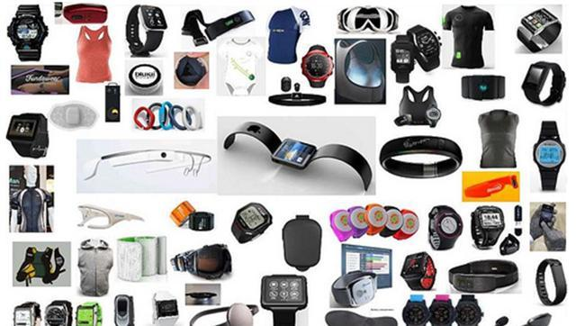

Potential Scaling Opportunities
Reduces Insurance Costs
Facilitates Usage based Insurance (88% of millennials prefer this)
Reduces Healthcare Costs
Premium Discounts (>50% millennials)
Data Mining for Insurance / Data Aggregation for customer
125 Million units are expected to be shipped in 2019
Accurate Medical Diagnosis
Treatment Optimization
Diet Management Plans
Emergency Health Services for Seniors
Reduced readmissions & emergency admissions to hospitals

Slide 4



Savings Insurance Costs
Risk selection & Underwriting
Info Gathering (Point of customer verification)
Risk selection and placing risk in class (Point of decision)
Save $25
200,000 apps/yr
5 million
Think about it!
More than 40 million adults use wearables in US today.
48% of those using wearable devices are millennials.
More than 50% of millennials are willing to share personal wearable data for premium discounts (Usage based Insurance).
80% of millennials will be buying life insurance as they go thru life changing events.

Slide 5
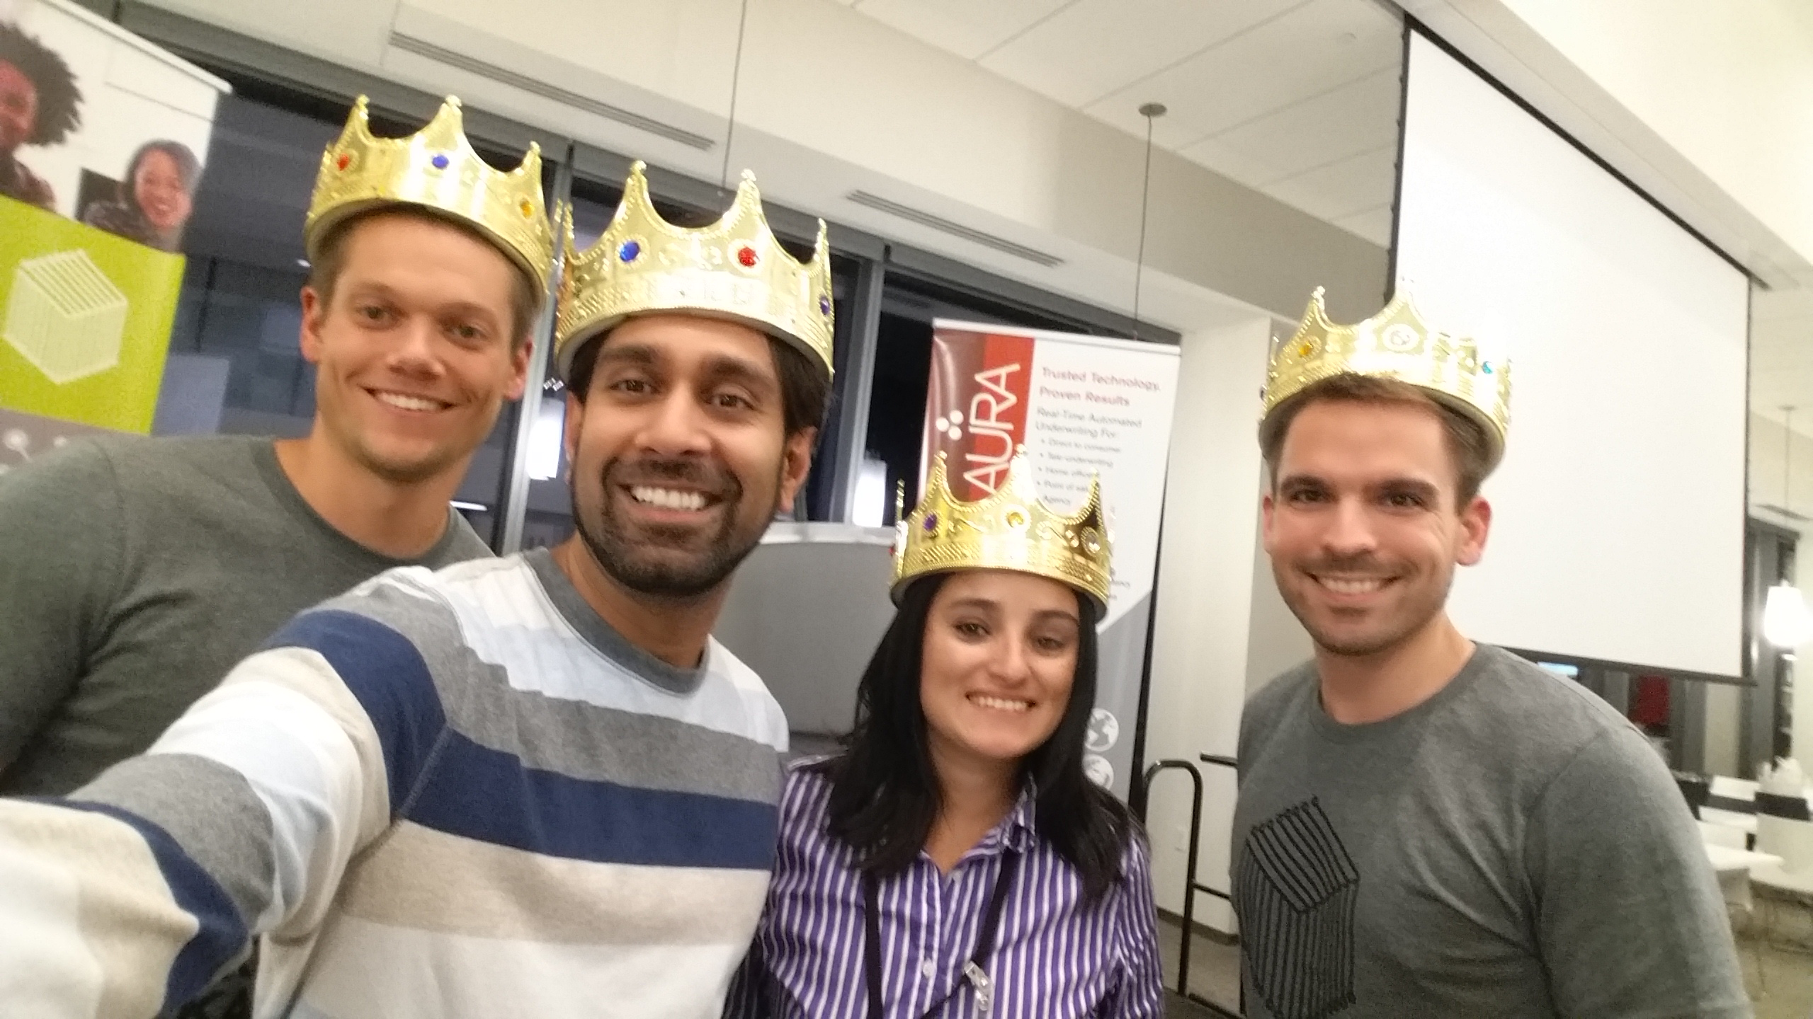
Thank you!

